Slide 1

Artificial intelligence-based spam filtering with neurolinguistic approach using PyTorch framework
Tóth Balázs

Slide 2
CONTENTS
About the project
Hyperparameters
Data collection and preprocessing
Model architecture
Neural network
Training process
Evaluation metrics
Further improvements and comparisons
1/9

Slide 3



About the project
Stack
Python
PyTorch (AI)
Flask (API)
Goals
Easy implementation to any application
Prevent users from malicious content
2/9

Slide 4

Hyperparameters
Learning rate = 0.001
Epochs = 20
Optimizer type = Adam
Loss function = Cross-entropy
Classes
Spam = 1
Not Spam = 0
3/9
Notes:
Learning rate, where the rate at which the model adjusts its weight during training and also plays a crucial role in determining the convergence and stability of the training process.
Batch size, where the number of data samples used in each iteration of the training process and also it affects the speed of convergence and memory requirements.
Number of epochs, where the number of the entire dataset is passed through the model during training and it determines the duration of the training process.

Slide 5
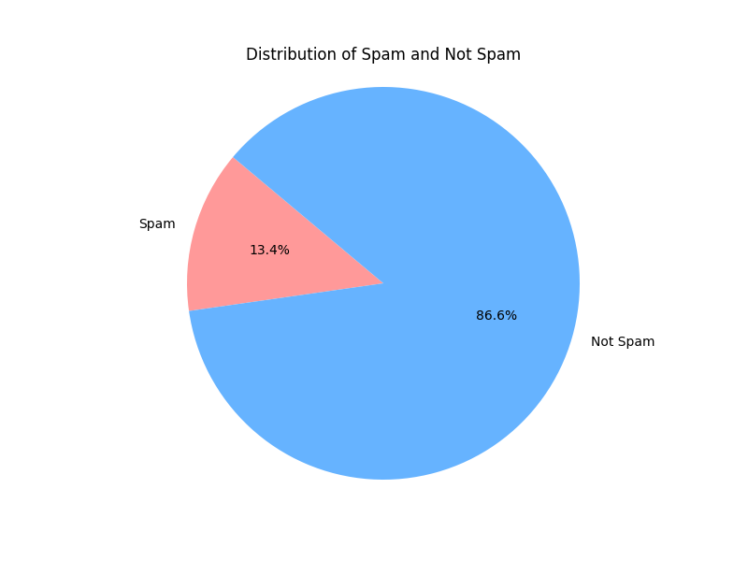
Data collection and preprocessing
Text classification labels
Text, the message
Class, the classification of the message (0 or 1)
Preprocessing
Classification
Extracting features from text (CountVectorizer)
Converting data to PyTorch tensors
4/9

Slide 6
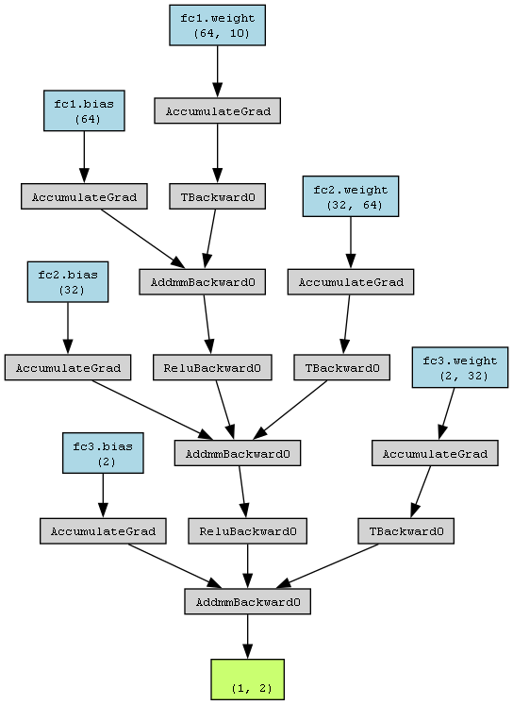
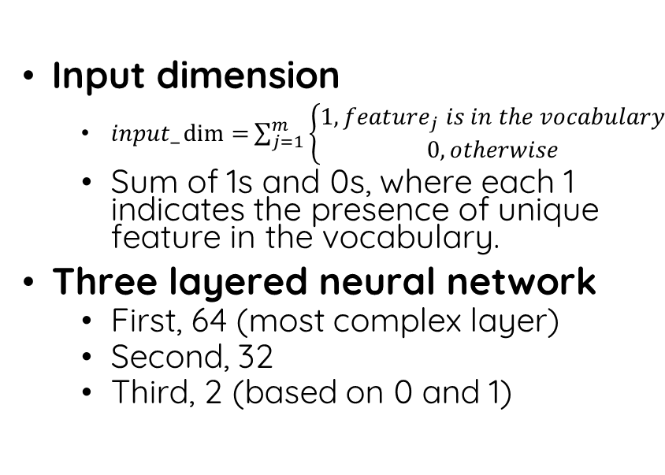
Model architecture
Input dimension
$input_\dim{=}\sum_{j=1}^{m}{\left\{\begin{aligned}1, {feature}_{j} is in the vocabulary \\ 0, otherwise\end{aligned}\right.}$
Sum of 1s and 0s, where each 1 indicates the presence of unique feature in the vocabulary.
Three layered neural network
First, 64 (most complex layer)
Second, 32
Third, 2 (based on 0 and 1)
5/9

Slide 7
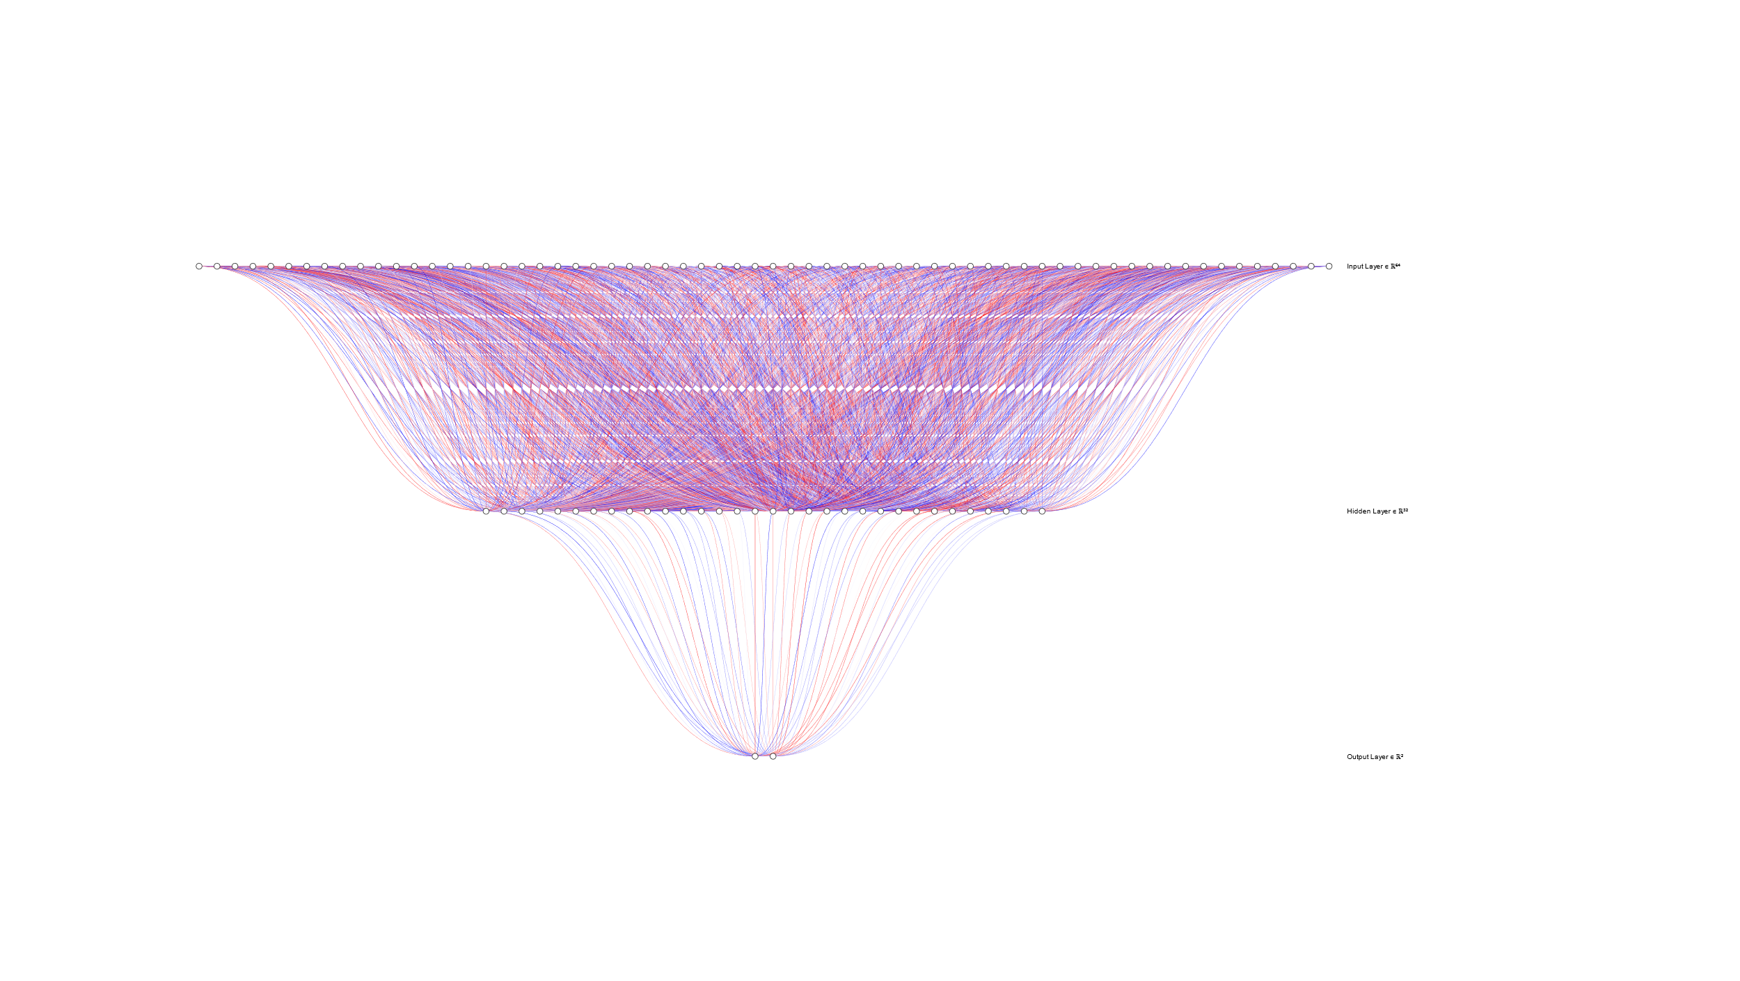
Neural network
6/9

Slide 8
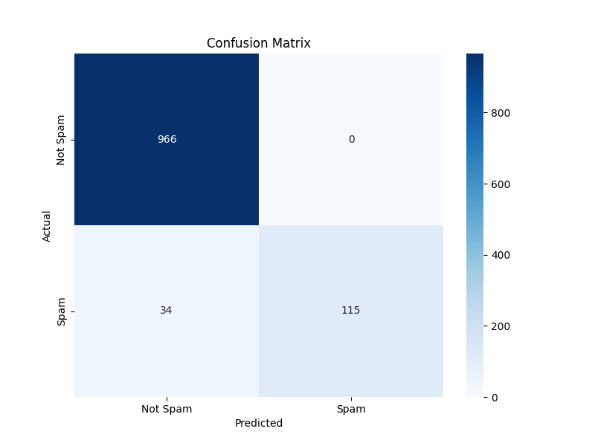
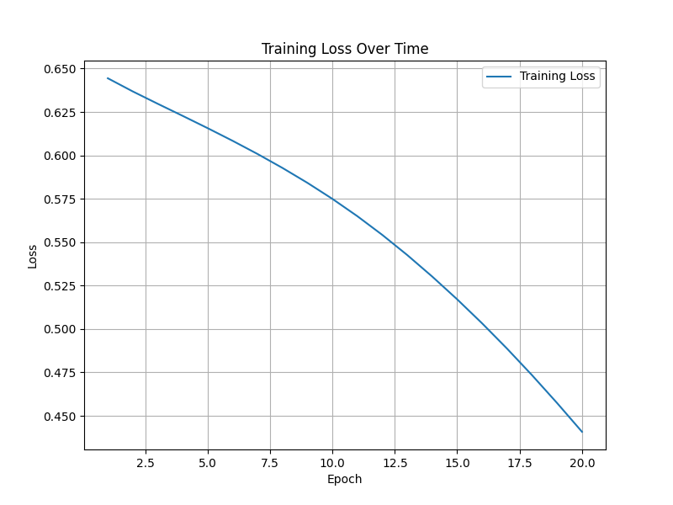
Training process
7/9
Notes:
True Positives (TP): The model correctly predicted instances that are positive.
True Negatives (TN): The model correctly predicted instances that are negative.
False Positives (FP): The model incorrectly predicted instances as positive when they are actually negative.
False Negatives (FN): The model incorrectly predicted instances as negative when they are actually positive.

Slide 9

Evaluation metrics
Accuracy = $\frac{TP + TN}{TP + TN + FP + FN}$ = $\frac{966+115}{966+115+34 +0}$ = 0.9695
Precision (Positive Predictive Value) = $\frac{TP}{TP+FP}$ = $\frac{966}{966+34}$ = 0.96
Recall (Sensitivity, True Positive Rate) = $\frac{TP}{TP+FN}$ = $\frac{966}{966+0}$ = 1
F1 score = 2 $×\frac{Precision × Recall}{Precision+ Recall}$ = 2 $×\frac{Precision × Recall}{Precision + Recall}$ = 0.9795
8/9
Notes:
Precision: The proportion of predicted spam messages that are actually spam.
Recall: The proportion of actual spam messages that were correctly identified by the model.

Slide 10



Further improvements and comparison
Hyperparameter tuning
Collecting more and more data
More output
9/9

Slide 11

The end

